Slide 1
Sales Training Deck
TEMPLATE
your logo
Notes:
Goal for our call: share our solution in the context of your strategy and goals. What would be a good outcome from this call for you?
Our Customers: We’re really fortunate to work with our customers, companies like Genesis, CBRE, Euromonitor, AMEND and more - and we’ll weave their stories throughout this conversation. Their success in launching products and creating scalable, recurring revenue is our ultimate metric.

Slide 2
Overview / Agenda
Introduction to the New Product
The Pitch
Pricing
Sales Enablement Tools
Q&A
Notes:
Transition In: Our solution rotates around three themes of Assess, Enable and Execute. I’ll dive a bit into these and demo how it works
Assessing your productization requirements is about delivering data in the context of your strategy - knowing where to start and focus is incredibly hard, so we help you focus your resources on just a few things that drive revenue, get your team aligned, and measure your progress over time
Enabling product mindset happens through programs that build essential product skills and practices on your team and across the org. We help you learn by doing - it’s not theoretical - and build your own company’s productization playbook for repeatability
Executing on your initiatives draws on our productization coaches and a network of your peers; one CEO describes this as “being their sherpa” in productization; your team will achieve their outcomes faster and implement best practices with more confidence
Transition Out: I’ll quickly bring each of these to life.

Slide 3
Introduction to the New Product
Name of Presenter (if applicable)
Notes:
Goal for our call: share our solution in the context of your strategy and goals. What would be a good outcome from this call for you?
Our Customers: We’re really fortunate to work with our customers, companies like Genesis, CBRE, Euromonitor, AMEND and more - and we’ll weave their stories throughout this conversation. Their success in launching products and creating scalable, recurring revenue is our ultimate metric.

Slide 4
A Reminder of Our Product Strategy
Notes:
Transition In: Our solution rotates around three themes of Assess, Enable and Execute. I’ll dive a bit into these and demo how it works
Assessing your productization requirements is about delivering data in the context of your strategy - knowing where to start and focus is incredibly hard, so we help you focus your resources on just a few things that drive revenue, get your team aligned, and measure your progress over time
Enabling product mindset happens through programs that build essential product skills and practices on your team and across the org. We help you learn by doing - it’s not theoretical - and build your own company’s productization playbook for repeatability
Executing on your initiatives draws on our productization coaches and a network of your peers; one CEO describes this as “being their sherpa” in productization; your team will achieve their outcomes faster and implement best practices with more confidence
Transition Out: I’ll quickly bring each of these to life.

Slide 5
A Reminder of [customer problem / business challenge / marketplace dynamics]
Notes:
Transition In: Our solution rotates around three themes of Assess, Enable and Execute. I’ll dive a bit into these and demo how it works
Assessing your productization requirements is about delivering data in the context of your strategy - knowing where to start and focus is incredibly hard, so we help you focus your resources on just a few things that drive revenue, get your team aligned, and measure your progress over time
Enabling product mindset happens through programs that build essential product skills and practices on your team and across the org. We help you learn by doing - it’s not theoretical - and build your own company’s productization playbook for repeatability
Executing on your initiatives draws on our productization coaches and a network of your peers; one CEO describes this as “being their sherpa” in productization; your team will achieve their outcomes faster and implement best practices with more confidence
Transition Out: I’ll quickly bring each of these to life.

Slide 6
[The Product/Service/Offer]
Notes:
Transition In: Our solution rotates around three themes of Assess, Enable and Execute. I’ll dive a bit into these and demo how it works
Assessing your productization requirements is about delivering data in the context of your strategy - knowing where to start and focus is incredibly hard, so we help you focus your resources on just a few things that drive revenue, get your team aligned, and measure your progress over time
Enabling product mindset happens through programs that build essential product skills and practices on your team and across the org. We help you learn by doing - it’s not theoretical - and build your own company’s productization playbook for repeatability
Executing on your initiatives draws on our productization coaches and a network of your peers; one CEO describes this as “being their sherpa” in productization; your team will achieve their outcomes faster and implement best practices with more confidence
Transition Out: I’ll quickly bring each of these to life.

Slide 7
What’s Next?
This is the beginning; not the end… We will continue to learn from the market
We will…

Slide 8
The Pitch
Name of Presenter (if applicable)
Notes:
Goal for our call: share our solution in the context of your strategy and goals. What would be a good outcome from this call for you?
Our Customers: We’re really fortunate to work with our customers, companies like Genesis, CBRE, Euromonitor, AMEND and more - and we’ll weave their stories throughout this conversation. Their success in launching products and creating scalable, recurring revenue is our ultimate metric.

Slide 9
[The Product/Service/Offer]
Notes:
Transition In: Our solution rotates around three themes of Assess, Enable and Execute. I’ll dive a bit into these and demo how it works
Assessing your productization requirements is about delivering data in the context of your strategy - knowing where to start and focus is incredibly hard, so we help you focus your resources on just a few things that drive revenue, get your team aligned, and measure your progress over time
Enabling product mindset happens through programs that build essential product skills and practices on your team and across the org. We help you learn by doing - it’s not theoretical - and build your own company’s productization playbook for repeatability
Executing on your initiatives draws on our productization coaches and a network of your peers; one CEO describes this as “being their sherpa” in productization; your team will achieve their outcomes faster and implement best practices with more confidence
Transition Out: I’ll quickly bring each of these to life.

Slide 10
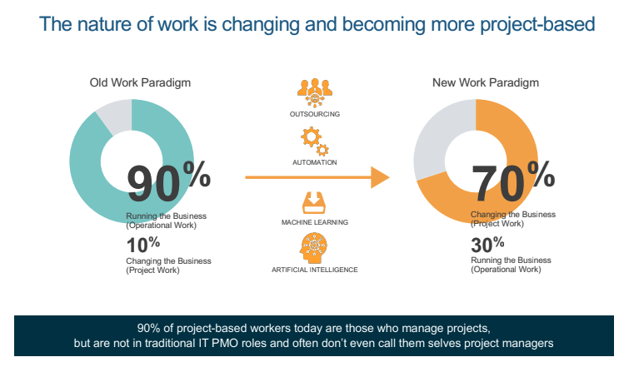
[State customer problem / business challenge / market need with data, visualization to support]
for example →
Notes:
Transition In: Our solution rotates around three themes of Assess, Enable and Execute. I’ll dive a bit into these and demo how it works
Assessing your productization requirements is about delivering data in the context of your strategy - knowing where to start and focus is incredibly hard, so we help you focus your resources on just a few things that drive revenue, get your team aligned, and measure your progress over time
Enabling product mindset happens through programs that build essential product skills and practices on your team and across the org. We help you learn by doing - it’s not theoretical - and build your own company’s productization playbook for repeatability
Executing on your initiatives draws on our productization coaches and a network of your peers; one CEO describes this as “being their sherpa” in productization; your team will achieve their outcomes faster and implement best practices with more confidence
Transition Out: I’ll quickly bring each of these to life.

Slide 11
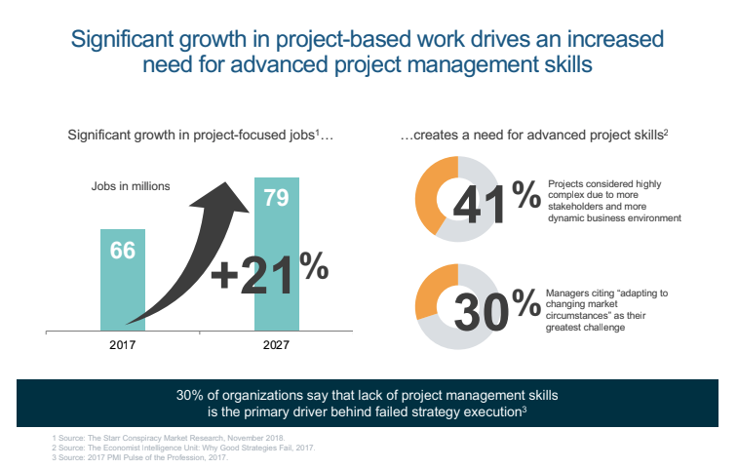
[State another customer problem / business challenge / market need with data, visualization to support]
for example →
Notes:
Transition In: Our solution rotates around three themes of Assess, Enable and Execute. I’ll dive a bit into these and demo how it works
Assessing your productization requirements is about delivering data in the context of your strategy - knowing where to start and focus is incredibly hard, so we help you focus your resources on just a few things that drive revenue, get your team aligned, and measure your progress over time
Enabling product mindset happens through programs that build essential product skills and practices on your team and across the org. We help you learn by doing - it’s not theoretical - and build your own company’s productization playbook for repeatability
Executing on your initiatives draws on our productization coaches and a network of your peers; one CEO describes this as “being their sherpa” in productization; your team will achieve their outcomes faster and implement best practices with more confidence
Transition Out: I’ll quickly bring each of these to life.

Slide 12
Illustrate what your product will do to address these challenges, problems, dynamics – on this and subsequent slides
Notes:
Transition In: Our solution rotates around three themes of Assess, Enable and Execute. I’ll dive a bit into these and demo how it works
Assessing your productization requirements is about delivering data in the context of your strategy - knowing where to start and focus is incredibly hard, so we help you focus your resources on just a few things that drive revenue, get your team aligned, and measure your progress over time
Enabling product mindset happens through programs that build essential product skills and practices on your team and across the org. We help you learn by doing - it’s not theoretical - and build your own company’s productization playbook for repeatability
Executing on your initiatives draws on our productization coaches and a network of your peers; one CEO describes this as “being their sherpa” in productization; your team will achieve their outcomes faster and implement best practices with more confidence
Transition Out: I’ll quickly bring each of these to life.

Slide 13
Illustrate the consequences and costs of not addressing the challenges, problems, dynamics – on this and subsequent slides
Notes:
Transition In: Our solution rotates around three themes of Assess, Enable and Execute. I’ll dive a bit into these and demo how it works
Assessing your productization requirements is about delivering data in the context of your strategy - knowing where to start and focus is incredibly hard, so we help you focus your resources on just a few things that drive revenue, get your team aligned, and measure your progress over time
Enabling product mindset happens through programs that build essential product skills and practices on your team and across the org. We help you learn by doing - it’s not theoretical - and build your own company’s productization playbook for repeatability
Executing on your initiatives draws on our productization coaches and a network of your peers; one CEO describes this as “being their sherpa” in productization; your team will achieve their outcomes faster and implement best practices with more confidence
Transition Out: I’ll quickly bring each of these to life.

Slide 14
Example Subscription-Based Model
Plan
Learn
Apply
Adopt
MATURITY ASSESSMENTS
ELEARNING
DIGITAL COACH
MICROLEARNING
CERTIFICATION OPTIONS
OPEN ENROLLMENT
ACTION PLANNING
WEBINARS WITH EXPERTS
ONSITE INSTRUCTOR
TEMPLATES
Benefits of All Access Membership:
Access to all Learning Solutions
Flat Fee Per Learner for One Year of Access
Built to Sustain Behavior Change
Anytime Access to Learning Tailored to Learner Needs
Dedicated Implementation Consultant

Slide 15
Include detailed pages to explain model

Slide 16
[Your Product] Differentiated Features
Notes:
Transition In: Our solution rotates around three themes of Assess, Enable and Execute. I’ll dive a bit into these and demo how it works
Assessing your productization requirements is about delivering data in the context of your strategy - knowing where to start and focus is incredibly hard, so we help you focus your resources on just a few things that drive revenue, get your team aligned, and measure your progress over time
Enabling product mindset happens through programs that build essential product skills and practices on your team and across the org. We help you learn by doing - it’s not theoretical - and build your own company’s productization playbook for repeatability
Executing on your initiatives draws on our productization coaches and a network of your peers; one CEO describes this as “being their sherpa” in productization; your team will achieve their outcomes faster and implement best practices with more confidence
Transition Out: I’ll quickly bring each of these to life.

Slide 17
[Client] partners with [You] to [outcome]
add client logo
Challenge
Insert…
Solution
Insert…
Business Results
Insert…

Slide 18
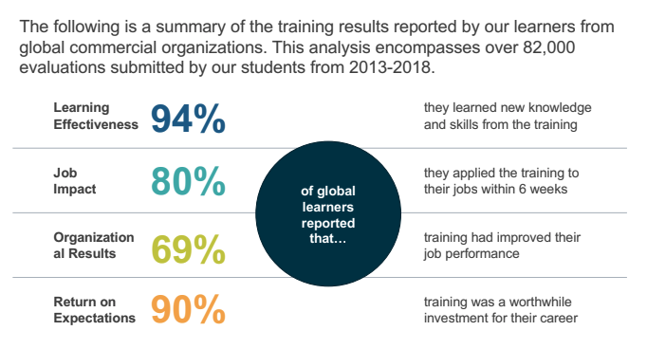
Our Impact By The Numbers
for example →

Slide 19
Pricing
Name of Presenter (if applicable)
Notes:
Goal for our call: share our solution in the context of your strategy and goals. What would be a good outcome from this call for you?
Our Customers: We’re really fortunate to work with our customers, companies like Genesis, CBRE, Euromonitor, AMEND and more - and we’ll weave their stories throughout this conversation. Their success in launching products and creating scalable, recurring revenue is our ultimate metric.

Slide 20
Why Are We Changing? (if applicable)
To address the changing needs of …
To create a repeatable, sustainable solution …
To meet the growing demand for …

Slide 21
Packages / Pricing
Benefits / Features | Package A | Package B | Package C
Add… | X | X | X
 | X | X | X
 | X | X | X
 |  | X | X
 |  |  | X
 |  |  | X
SOLUTION COST / INVESTMENT | $XXX | $XXX | $XXX

Slide 22
Sample Use Cases
Notes:
Goal for our call: share our solution in the context of your strategy and goals. What would be a good outcome from this call for you?
Our Customers: We’re really fortunate to work with our customers, companies like Genesis, CBRE, Euromonitor, AMEND and more - and we’ll weave their stories throughout this conversation. Their success in launching products and creating scalable, recurring revenue is our ultimate metric.

Slide 23
Add Use Cases

Slide 24
Overview of Selling Tools
Notes:
Goal for our call: share our solution in the context of your strategy and goals. What would be a good outcome from this call for you?
Our Customers: We’re really fortunate to work with our customers, companies like Genesis, CBRE, Euromonitor, AMEND and more - and we’ll weave their stories throughout this conversation. Their success in launching products and creating scalable, recurring revenue is our ultimate metric.

Slide 25
Sales Enablement Tools
Pitch Deck
Follow Up Sales Deck
Sell Sheet & Pricing Sheets
Playbooks
Video / Demo
Email Templates
(these are examples)

Slide 26
Next Steps
PRODUCT
insert…
SALES
insert…
MARKETING
insert…

Slide 27
Questions?
Notes:
Goal for our call: share our solution in the context of your strategy and goals. What would be a good outcome from this call for you?
Our Customers: We’re really fortunate to work with our customers, companies like Genesis, CBRE, Euromonitor, AMEND and more - and we’ll weave their stories throughout this conversation. Their success in launching products and creating scalable, recurring revenue is our ultimate metric.

