Slide 1
Pricing Sheets
Examples of Communicating Value
Notes:
See Productize, Pages 134 - 136

Slide 2
Basic Components of an Internal Pricing Sheet
Base Package Information:
Region
Package Tier
Units of Usage Driver (e.g. seats)
Term Length & Payment Options
Features included per tier
Add-On Information:
List of available Add-on or bolt-ons
Pricing per add-on & units of add-on
Available Discounts and Incentives:
List of discounts & Incentives
Rules on discount approvals required
Rules on term flexibility and approvals required
Most common mistakes organizations make:
Building a Statement of Work (SOW) rather than a Term Sheet
Using too many variables to determine the base pricing vs picking the primary value driver
Including too many features as unique a-la-carte add-ons vs aligning features to tiers
Lack of clarity to the sales team on what they can customize before needing approval
Pricing does not necessarily have to be simple, but it does have to be easy to sell, so must make sense to the customer and not feel like a confusing black box.

Slide 3
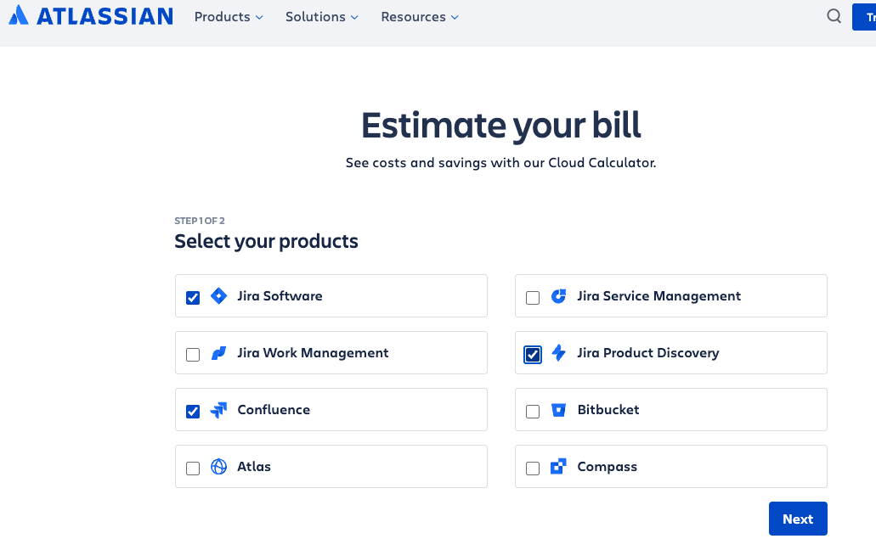
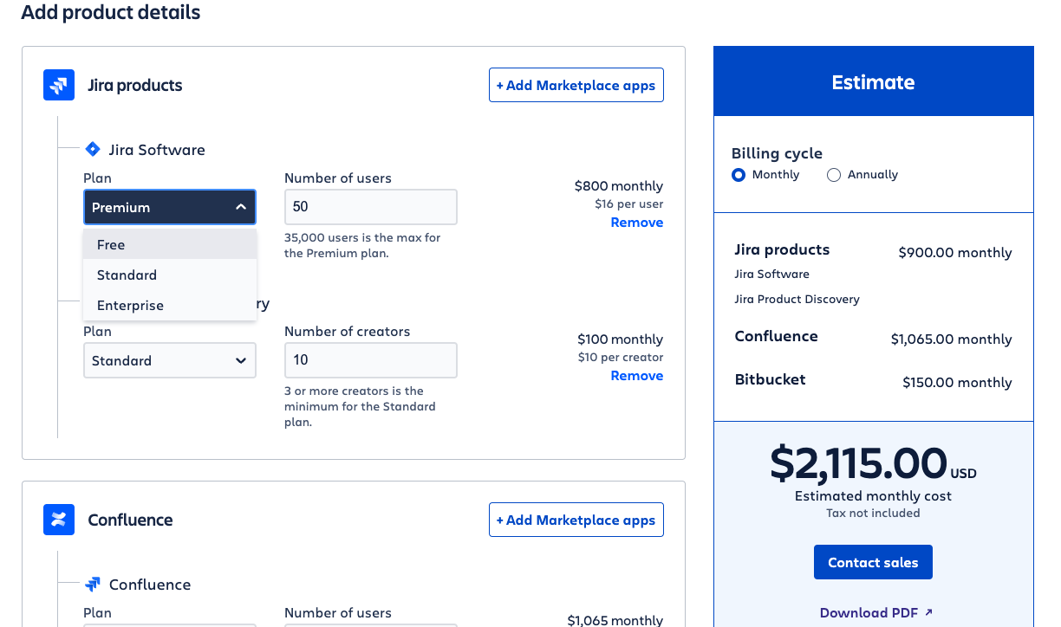
Atlassian Pricing Example
https://www.atlassian.com/software/pricing-calculator
Ability to include add-ons
Pick Tier, then number of users
Terms impact price
Start by selecting products

Slide 4
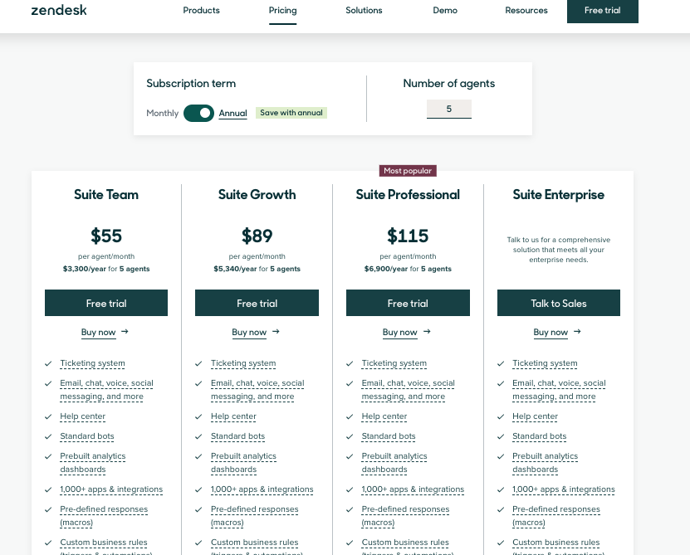
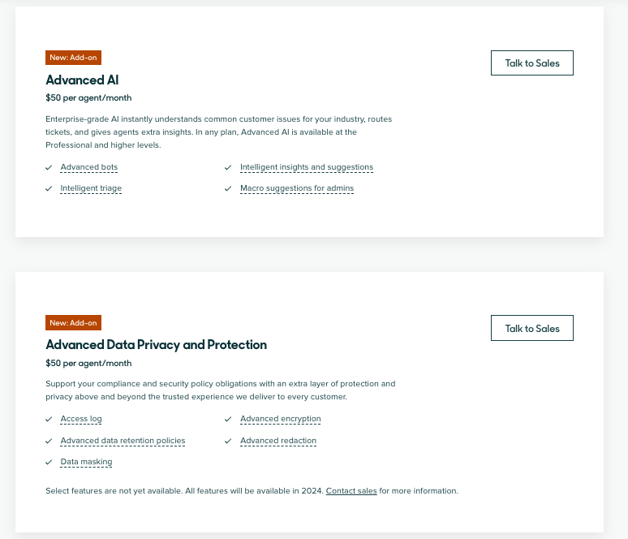
Zendesk Pricing Example
https://www.zendesk.com/pricing/
Pick terms
Select main value driver, Agents
See Tiers aligned to customer segments and included features
Ability to include add-ons

Slide 5
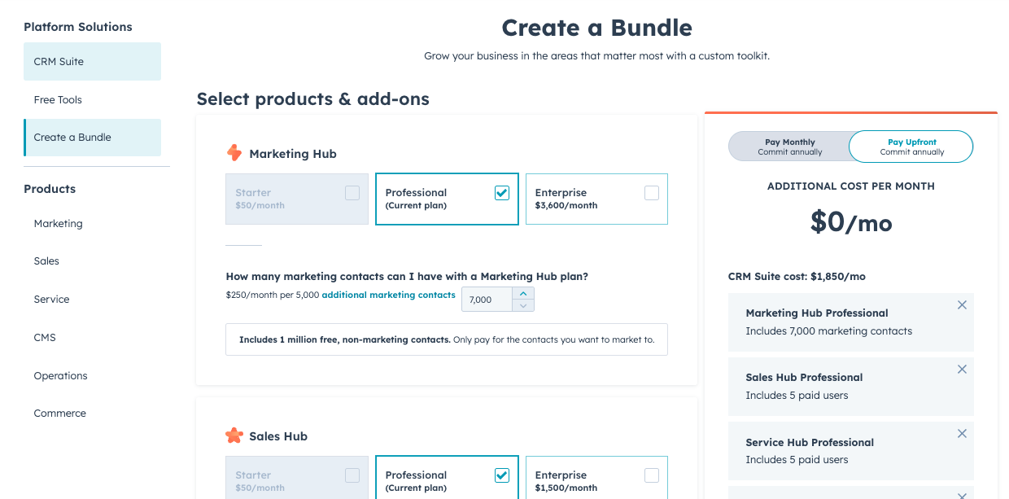
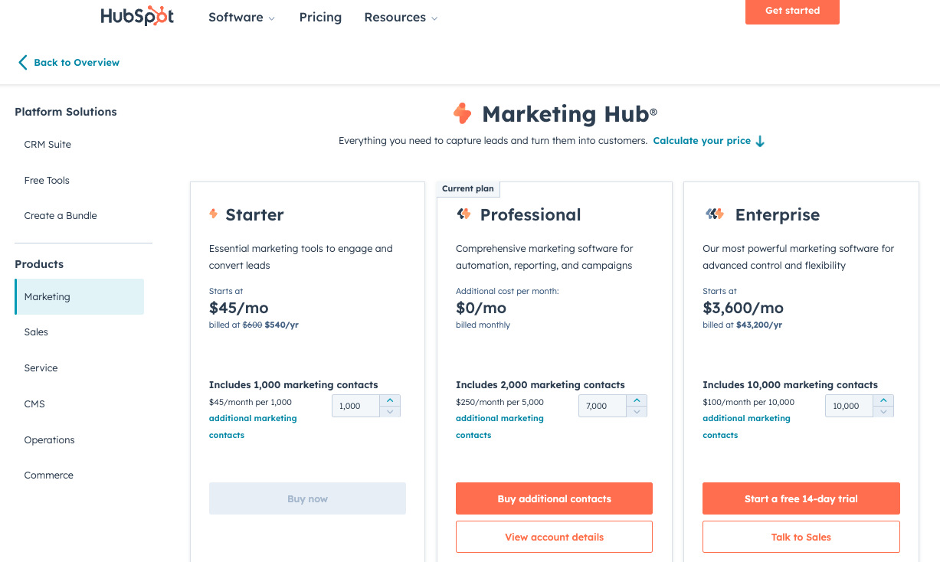
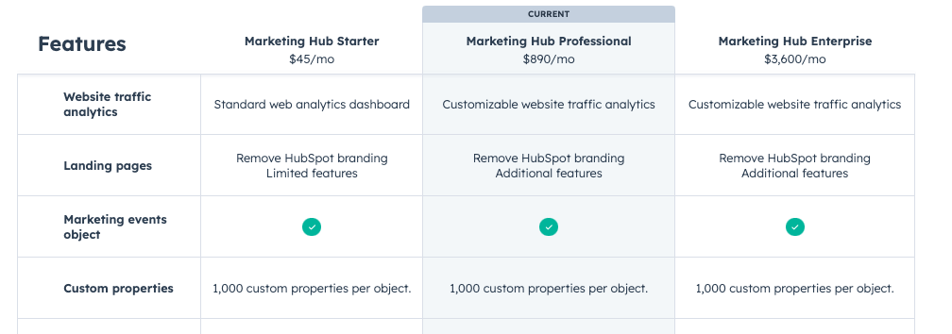
Hubspot Pricing Example
https://www.hubspot.com/pricing/
Bundle or price by product
Pick Tiers
Adjust value driver, Contacts
See features under each tier

Slide 6
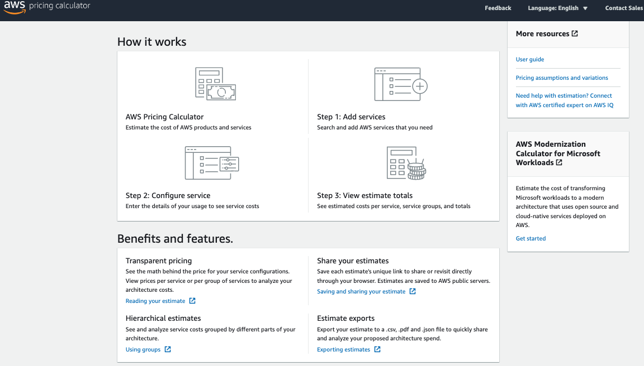
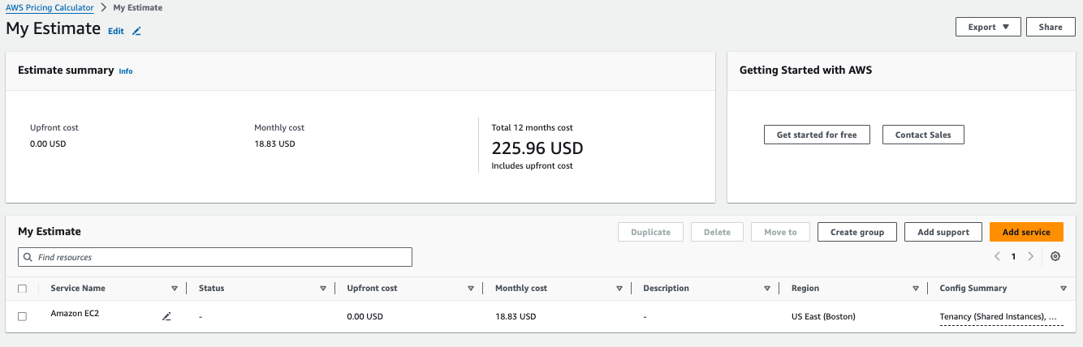
AWS Pricing Example
https://calculator.aws/#/
More complex product has a calculator & pricing workflow
Even with complexity, provides simple price / month
Select products and units of value to build product price list

Slide 7
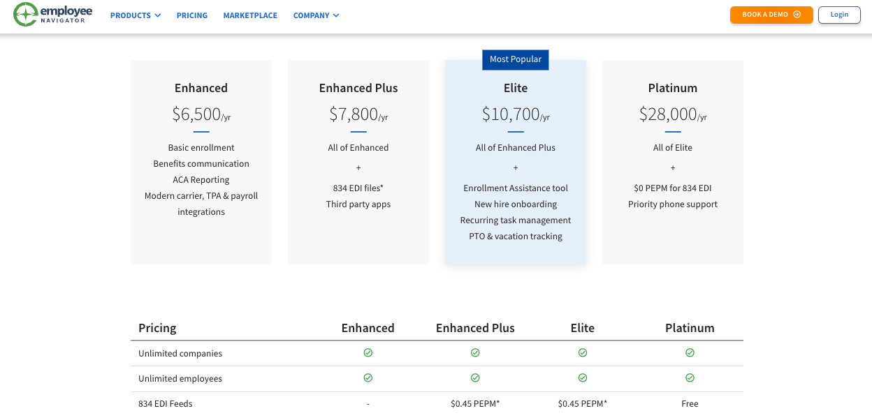
Employee Navigator Pricing Example
Specific to Sean’s past experience. Reach out for an in-depth explanation.
https://www.employeenavigator.com/pricing/
Simple tiers with additional features to align to customer segments.
Enterprise pricing for Brokers incentivized higher adoption over industry common practice of per-employe-per month pricing
The next iteration will turn fixed enterprise pricing to per-seat pricing.
Includes variable pricing on usage for data integrations. This revenue scaled with higher adoption rates incentivized by lower enterprise pricing.
Not shown here are data integration prices for Insurance Carriers - the other side of the marketplace.

