Slide 1
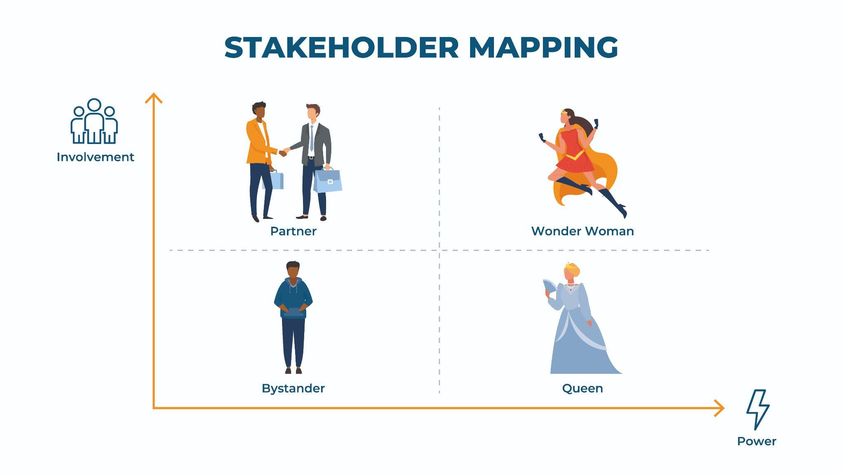
Map Stakeholders
Power is the stakeholder’s ability to make events happens and drive specific desired outcomes
Involvement is how much the stakeholder will participate and contribute towards the desired outcomes

Slide 2
Stakeholder Mapping Exercise
Partner
Wonder Woman
Instructions:
Step 1: Place stakeholders into the matrix.
Step 2: Place a star next to the person who is your biggest cheerleader.
Step 3: Place a square next to the person who might be your biggest roadblock.
Step 4: Utilize the stakeholder influence worksheet to identify the best ways to collaborate with each stakeholder.
High
Stakeholder
A
Involvement
Stakeholder
B
Stakeholder
C
Low
Bystander
Queen
Low
Power
High

